Slide 1
RUNGTA COLLEGE OF DENTAL SCIENCES & RESEARCH
Basic Terminologies of Dental Anatomy
DEPARTMENT OF ORAL PATHOLOGY

Slide 2
OBJECTIVES
To know about the various terminologies used to understand and label the morphologic and anatomical appearance of tooth from various aspects

Slide 3
Specific learning Objectives
Core areas* | Domain ** | Category #
Traits of teeth | COGNITIVE | MUST KNOW
Surfaces or Aspects of teeth Landmarks on teeth crown Landmarks on teeth root Elevations & Depressions Line angle Point angle Abnormalities of tooth morphology | COGNITIVE COGNITIVE COGNITIVE COGNITIVE COGNITIVE COGNITIVE | MUST KNOW MUST KNOW MUST KNOW MUST KNOW NICE TO KNOW DESIRED TO KNOW

Slide 4
Contents
Traits of teeth
Surfaces or Aspects of teeth
Landmarks on teeth (crown and root)
Line angle and point angle

Slide 5
Basic terminologies in Dental Anatomy

Slide 6
Traits of teeth ( 3/5 marks)
Surfaces or Aspects of teeth ( 3/5 marks)
Landmarks on teeth (3/5 marks)

Slide 7
Anatomical landmarks on Crown
Landmarks on root
Root trunk
Furcation
Apex of root
Apical foramen
Sulcus

Slide 8
Trait categories of teeth
A trait is a distinguishing characteristic
It’s a quality or attribute
Traits are as follows :
Set Traits
Arch Traits
Class Traits
Type Traits

Slide 9
Set Traits / Dentition Traits
Distinguishes teeth in primary dentition from permanent dentition
Eg : Primary teeth are whitish
: Permanent teeth are darker (yellowish white)

Slide 10
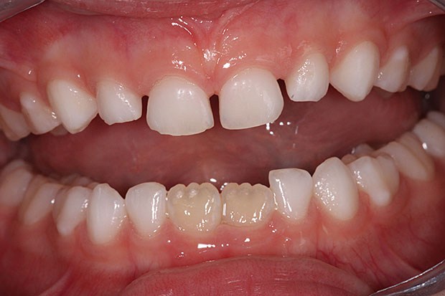
Lighter
Milky white ( RI = milk)
Darker
Yellowish – grayish white

Slide 11
Arch Traits
Distinguishes maxillary teeth from mandibular teeth
Eg : Maxillary molar has 3 roots
: Mandibular molar has 2 roots

Slide 12
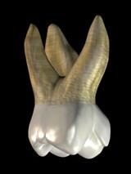

Slide 13
Class Traits
Distinguishes 4 classes of teeth – Incisor, Canine, Premolar & Molar
Eg : Incisors – straight incisal edge
: Canines – 1 cusp
: Premolars – 2 cusps
: Canines – 3-5 cusps

Slide 14
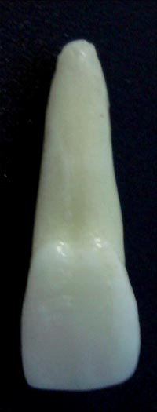
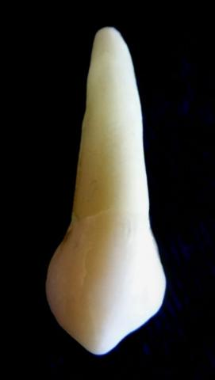

Slide 15
Type Traits
Differentiate teeth within one class
Eg : difference between lateral & central incisor
: difference between right & left canine
: difference between 1st & 2nd premolar

Slide 16
Surfaces of teeth
Five surfaces can be recognized on the crowns of all teeth
Anterior teeth | Posterior teeth
Labial | Buccal
Lingual / Palatal | Lingual / Palatal
Mesial | Mesial
Distal | Distal
Incisal | Occlusal

Slide 17
Labial – surface towards lips (anteriors)
Buccal – surface towards cheeks (posteriors)
Lingual / Palatal – surface facing towards tongue/palate
Mesial – surface nearest to median line
Distal - surface away from the median line
Incisal / Occlusal – surface that comes in contact with those of opposing teeth

Slide 18
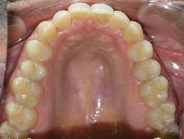
Palatal
Labial
Buccal

Slide 19
Lingual

Slide 20
M
M
D
D
M
M
D
D
M
M
D
M
D
M
M
D
D
M
D

Slide 21
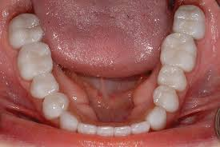
Occlusal surfaces = only in premolars & molars Incisal surfaces = only in incisors & canines
o
o
o
o
o
o
o
o
i
i
i
i
i
i

Slide 22
Distal + Mesial = Proximal surfaces
Labial + Buccal = Facial surfaces

Slide 23
Anatomical landmarks
Landmarks on root
Root trunk
Furcation
Apex of root
Apical foramen
Sulcus

Slide 24
Elevations
Cusp
An elevation on the crown portion of tooth making up a divisional part of occlusal surface
Canines & posterior teeth

Slide 25
Canine – cuspid (single cusp)
Premolars – bicuspids (double cusp)
2
1
1

Slide 26
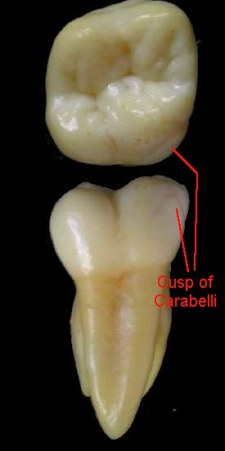
Cusp of Carabelli – 5th cusp
A pit, bump or cusp on the mesiolingual side of permanent maxillary molars.
2-3 mm above the occlusal level

Slide 27
Cingulum
Seen on the cervical third of the anterior teeth
Seen on the palatal/lingual surfaces
Develops from lingual lobe
Makes up major bulk of cervical third
Cingulum
Cingulum

Slide 28
Lobe
It is one of the primary sections of formation in the development of crown
Distal
Mesial
Labial

Slide 29
Mamelons
3 rounded protuberances found on the incisal ridges of newly erupted incisor teeth.
They represent the three developmental lobes:
Mesial
Labial
Distal
They soon disappear as incisal ridges get worn away due to mastication
Absent in primary incisors

Slide 30
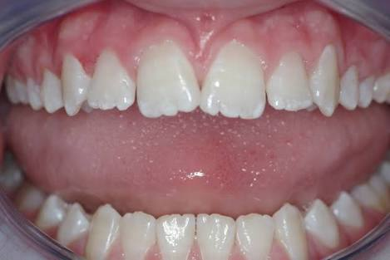
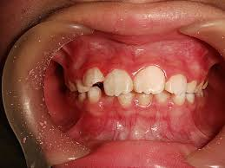
Present on incisal edges
Newly erupted incisors
3 elevations
Absent in primary incisors

Slide 32
Ridges
A linear elevation on the surface of tooth
Named according to location

Slide 33
Marginal Ridge
All teeth have 2 marginal ridges
Mesial
Distal
Rounded borders of enamel that forms mesial & distal margins of occlusal/incisal surfaces

Slide 34
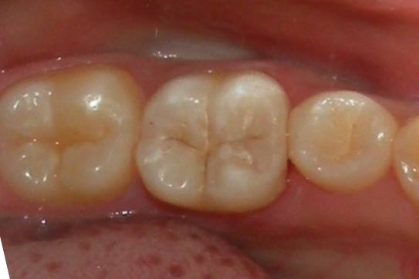
Mesial
Marginal
Ridge
Distal
Marginal
Ridge

Slide 35
Incisal Ridge, Lingual Ridge
Marginal ridges
Lingual ridges
Incisal ridges

Slide 36
Buccal cusp ridge – seen on buccal surface of tooth
Lingual cusp ridge – seen on lingual surface of tooth

Slide 37
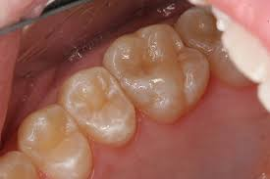
Oblique ridge
B
D
M
Seen only in maxillary molars
Seen in the occlusal aspect
Runs obliquely as a continuation between 2 cusps
Runs from mesiolingual cusp to distobuccal cusp
L/P

Slide 38
Ridge is reduced in center of occlusal surface
MB
DB
DL
ML

Slide 39
Line angles & Point angles
Line angle :
formed by junction of 2 surfaces
Named according to the joining surfaces
Anterior teeth – 6 line angles
Posterior teeth – 8 line angles

Slide 40
Depressions on tooth surface
Fossae
Depression or concavity on the lingual surface of anteriors

Slide 41
Sulcus : a long depression or valley on the occlusal surface of posterior teeth
Fossae – depression or concavity on lingual surface of anterior teeth & occlusal surface of posterior teeth

Slide 42
Landmarks of root
Root trunk – present only in multirooted teeth. It is undivided part of root near the cervical line
Furcation – place where the root trunk divides into separate roots
2 roots – bifurcation
3 roots - trifurcation
Apex of root – tip at the end of root

Slide 43
Summary
In order to understand tooth morphology, it is necessary to understand the anatomy of the structures within the tooth and to understand the stages of tooth development.
These stages give rise to the final morphology of a variety of human teeth with different surfaces and ridges, which are named using an entomologic system and the tissue composition of teeth at various stages of development, and provides insight into the vocabulary and numbering systems used to identify and describe human teeth

Slide 44
Take Home Message
Basic terminology is a mechanism to improve understanding of message by humans.

Slide 45
References
SN Bhaskar . Orban’s ,Oral Histology and embryology. 11th edition, Mosby 1998
Neville BW ,Damm DD ,Allen CM ,Bouquot JE . Oral and maxillofacial pathology , 2nd Edition .Philadelphia W.B. Saunders ;2002
Richard Tencate , Oral Histology development ,structure and function . 5th Edition ,1998
Carranza F.A., Michael G. Newman . Clinical periodontology 8,9,10th edition

Slide 46
Frequentely Asked Questions
Definition & terminologies – cusp/ fossa/ marginal ridges/ grooves/ embrassures/ ridges/ lobes/ pit & fissures / line angle / point angle (5/3 marks)
Cusp of Carabelli
Cingulum
Mammelons

